Slide 1
ESP32 Dev Module V4
IoT Project

Slide 2
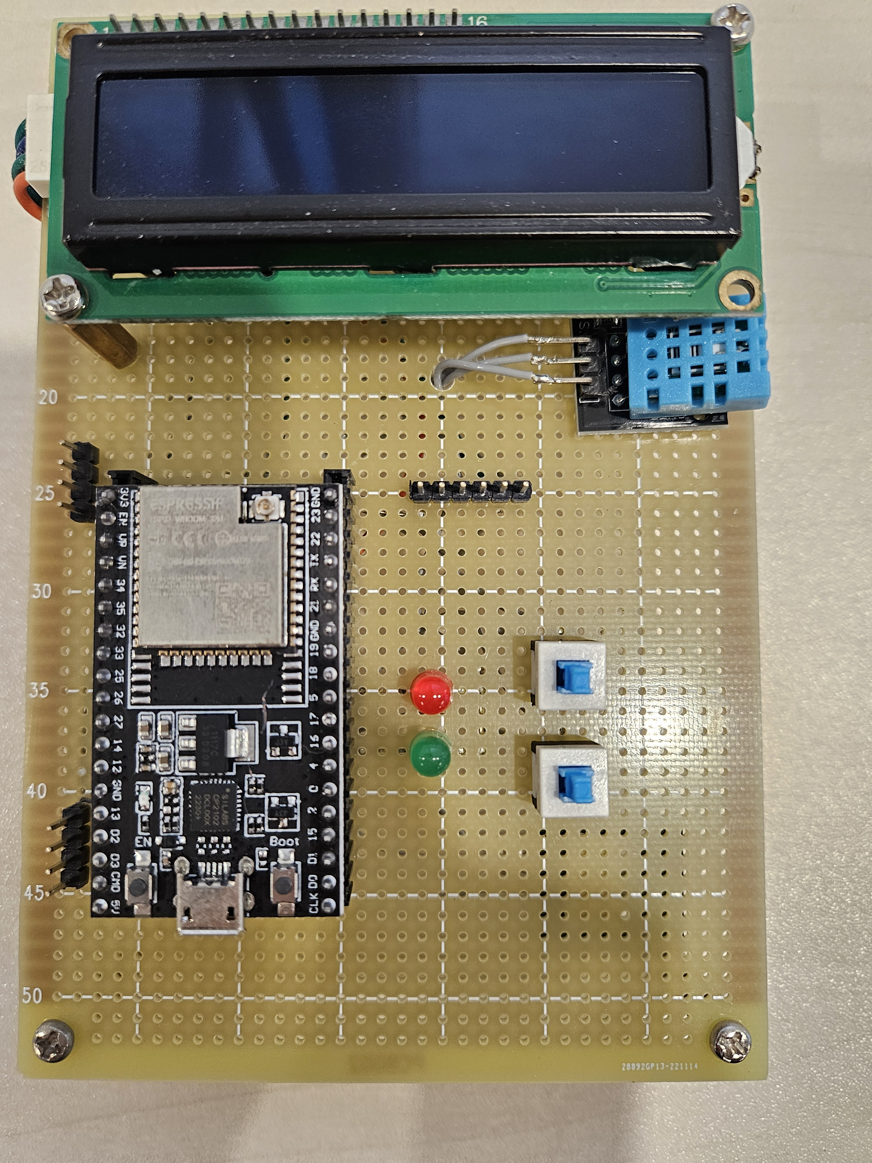
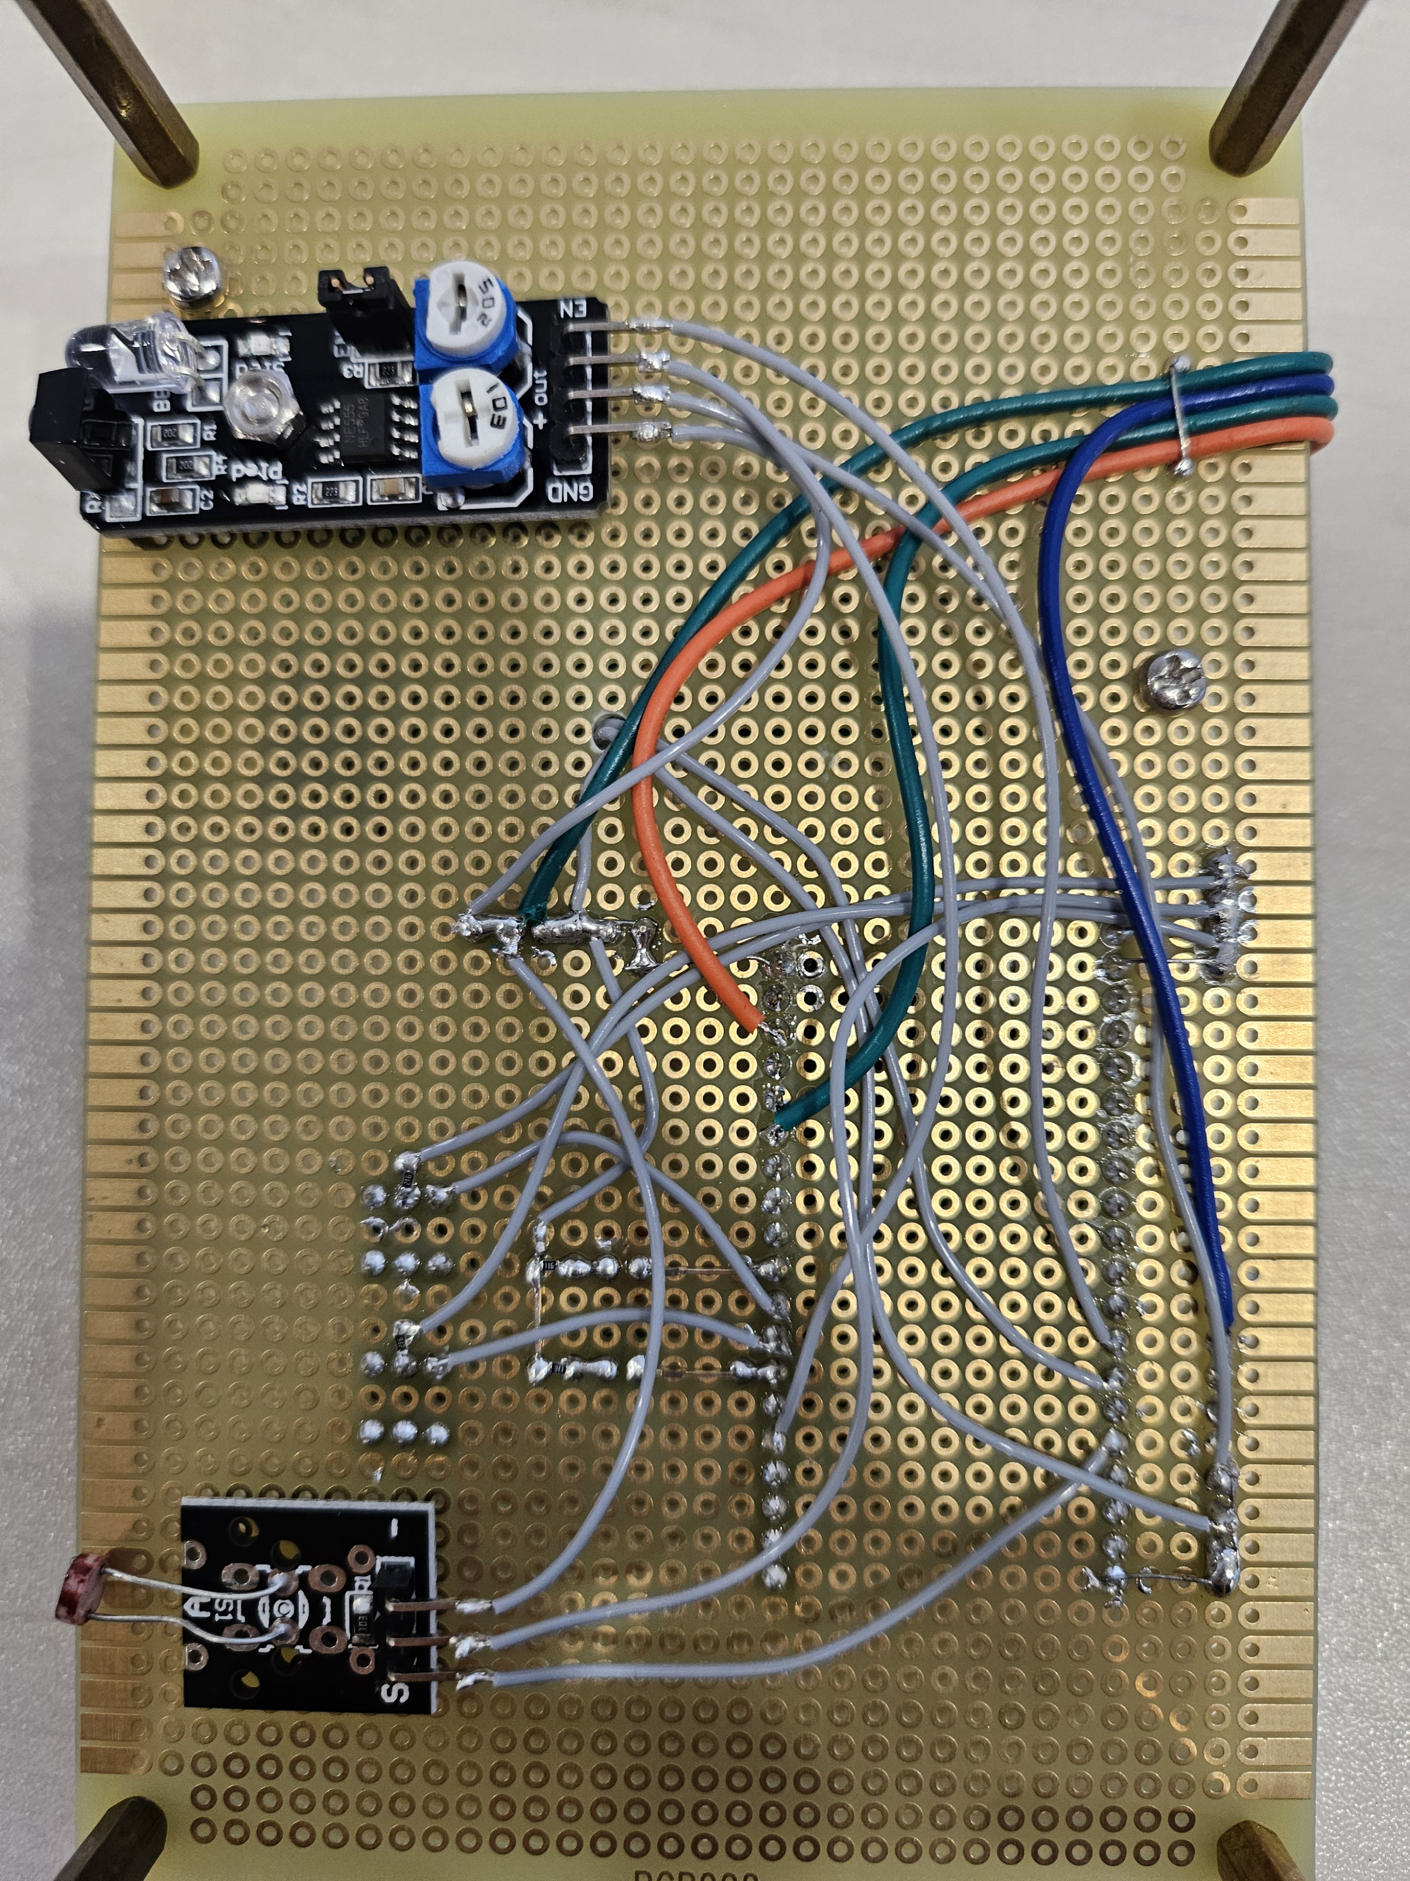
Hardware Layout

Slide 3
Hardware Detail
LCD display with HD44780 driver
Photo-resistor
Temperature &
Humidity
+3.3V
GND
LED1
BUT1
LED2
BUT2
+5V
Avoidance
PCB Top
PCB Bottom

Slide 4
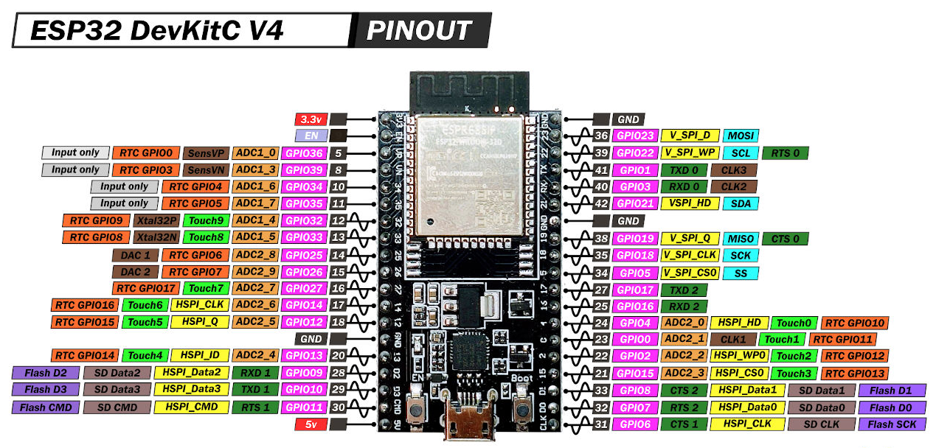
ESP32 Module Pinout

Slide 5


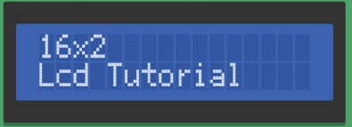
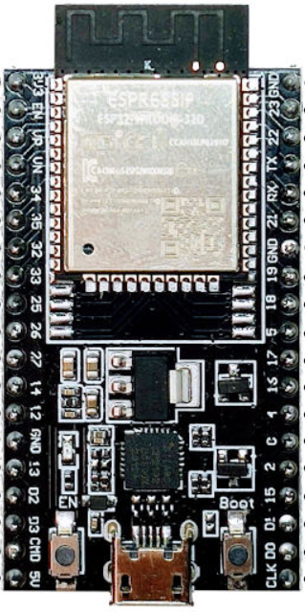
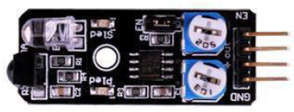
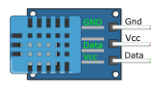
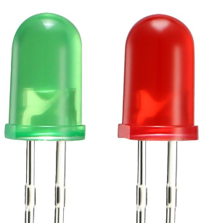
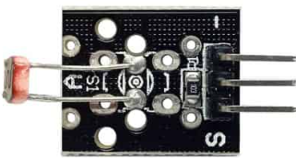
Hardware Configuration
+3.3V
GND
+5V
SDA
SCL
GPIO21
+5V
+3.3V
GPIO22
Avoidance
EN
GPIO14
+3.3V
GPIO2
10K
BUT1
GPIO17
10K
BUT2
GPIO16
Temperature &
Humidity
GPIO12
910
LED1
GPIO5
910
LED2
Photo-
resistance
GPIO4
GPIO13
GND
GND

Slide 6
Configuration Table
Sensor/Device | Interface | Remark
LCD Panel | SDA=GPIO21 SCL=GPIO22 | 16 x 2 Characters LCD module
Button1 (BUT1) | GPIO17 (Internal pull-down) | Push to high
Button2 (BUT2) | GPIO16 (Internal pull-down) | Push to high
LED Red (LED1) | GPIO5 | High to turn-on
LED Green (LED2) | GPIO4 | High to turn-on
Avoidance | Enable=GPIO14 Output=GPIO15 | Output=L → Obstacle Output=H → No obstacle
Temperature & Humidity | Data=D1 | Digital output of T and H values
Photo-resistance | Output=GPIO13 | Darkness: ~50kΩ Light: ~500Ω

Slide 7
Project scopes
Temperature and humidity measure and read at LCD display.
Flash LED Red (LED1) for every sample of captioned parameters.
Button 1 (BUT1) toggle to measure parameters of Avoidance and Photo-resistor.
Flash LED Green (LED2) for every sample of captioned parameters
Button 2 (BUT1) to try to enable/disable to WIFI connection to connect cloud base system.
If connected good, turn on LED2.
Cloud will collect all four sensor parameters: Temperature, humidity, avoidance and photo-resistor.

